Slide 1
Cryptocurrency historical prices
historical data ANALYSIS AND STORY TELLING OF Cryptocurrencies through the POWER-BI dashboard

Slide 2
context
Things like Block chain, Bitcoin, Bitcoin cash, Ethereum, Ripple etc are constantly coming in the news articles I read. So I wanted to understand more about it and this post helped me get started. Once the basics are done, the data scientist inside me started raising questions like:
How many cryptocurrencies are there and what are their prices and valuations?
Why is there a sudden surge in the interest in recent days?
So what next? Now that we have the price data, I wanted to dig a little more about the factors affecting the price of coins. I started of with Bitcoin and there are quite a few parameters which affect the price of Bitcoin. Thanks to Blockchain Info, I was able to get quite a few parameters on once in two day basis.
This will help understand the other factors related to Bitcoin price and also help one make future predictions in a better way than just using the historical price.

Slide 3
QUESTIONS WHICH CAN BE ANSWERED
Some of the questions which could be inferred from this dataset are:
How did the historical prices / market capitalizations of various currencies change over time?
Predicting the future price of the currencies
Which currencies are more volatile and which ones are more stable?
How does the price fluctuations of currencies correlate with each other?
Seasonal trend in the price fluctuations

Slide 4
DATASET DESCRIPTION
The dataset has one csv file for each currency. Price history is available on a daily basis from April 28, 2013. This dataset has the historical price information of some of the top crypto currencies by market capitalization.
Date : date of observation
Open : Opening price on the given day
High : Highest price on the given day
Low : Lowest price on the given day
Close : Closing price on the given day
Volume : Volume of transactions on the given day
Market Cap : Market capitalization in USD

Slide 5
acknowledgements
This data is taken from coinmarketcap and it is free to use the data.
Some dataset are taken from kaggle and github.
Most of the data is from forex exchange, its benefit has been taken on this project.
Get the knowledge about cryptocurrency through blockchain.

Slide 6
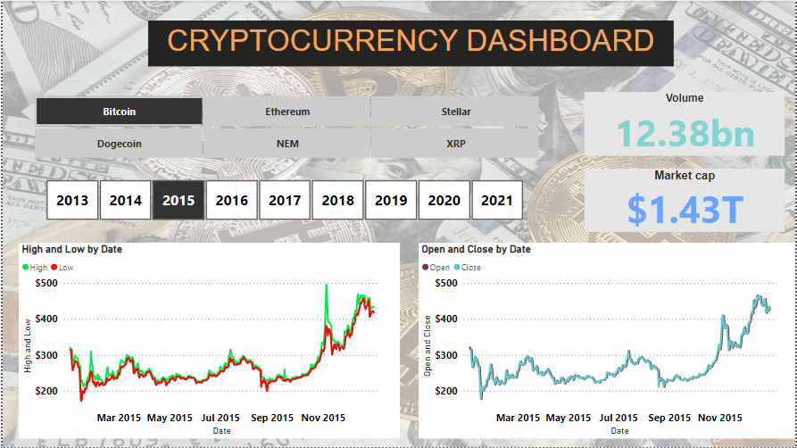
First look of cryptocurrency Dashboard

Slide 7
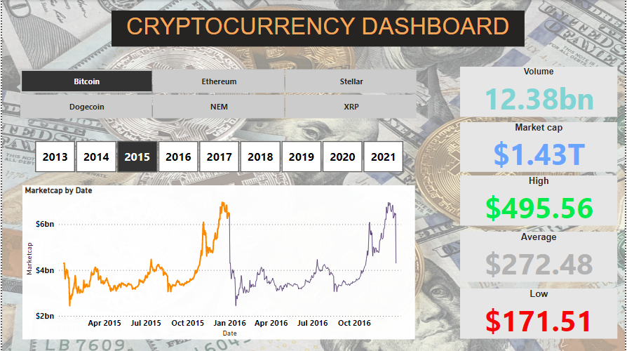
second look of cryptocurrency Dashboard

